Slide 1

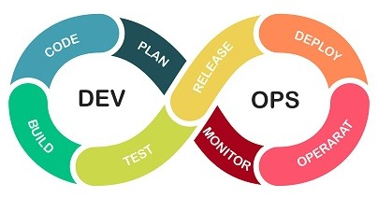
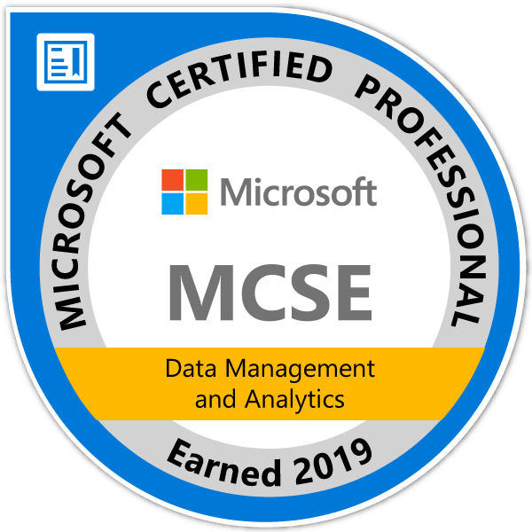


DevOps Your Databases
N: Paul Hunter Manager of Innovation at Accounting Firm
E: DallasNightOwl@gmail.com
T: @SqlNightOwl (in exile)
L: LinkedIn.com/in/PaulHunterMCSE

Slide 2
If you’re not doing DevOps for your databases… you’re working to hard.
- Paul Hunter

Slide 3
Agenda
Introductions
Delivery Story
What is… DevOps
What’s In It For You
DB DevOps - It Comes in Flavors?
Getting Started
Idempotent When & Where
Practice Your Pipeline
DevOps Tools
Resources

Slide 4
Introduction…
I got into the field accidentally and am largely self-taught
Over 25 years experience modeling, developing, building & delivering database solutions
First experience with SQL Server 6.0 (shortly after split from Sybase)
MCSE – Data Management & Analytics (2019)
FORG – Friend of RedGate (2019)
Continually honing my craft through continuously learning

Slide 5
Our Delivery Story
Where we started…
Release of the multi-tenant application affected two central databases (Audit and Central on one server), a Utility database on each server, and roughly 40+ Customer databases (common schema different data).
A Production Release was taking 4 people 4 days complete (120+ hours).
Production Release was inconsistent and often failed to deliver one or two overlooked features.
Where we are now…
Same application nothing has changed… except there are now more servers and 100+ databases
Releases take a little over two hours for one person. The database portion takes under 5 minutes.
Zero failures, 100% success rate, 100% consistent database delivery
Where we are going…
Cloud

Slide 6
What is DevOps
Gartner on DevOps
DevOps represents a change in IT culture, focusing on rapid IT service delivery through the adoption of agile, lean practices in the context of a system-oriented approach. DevOps emphasizes people (and culture), and it seeks to improve collaboration between operations and development teams. DevOps implementations utilize technology — especially automation tools that can leverage an increasingly programmable and dynamic infrastructure from a life cycle perspective. That’s nice… but what does it boil down to? It’s the process to reliably and repeatably get your stuff from Development into Operations.

Slide 7
What it is…
It’s a shift in thinking through a change in your culture that supports rapid and accurate delivery of development efforts to production - configuration, code & data resources.
It leverages automation tools to build, test and deliver new features for your supported applications.
It incorporates the Database into the development cycle.
Focuses on repeatable, consistent, and dependable delivery.

Slide 8
What’s In It For You?
It makes your life simpler!
You can answers questions management likes to know:
How long will it take to deliver code into production?
What happens if a release fails?
Has the code/release been tested?
How do we know there weren’t unapproved changes?
It’s a pre-planned and scripted process as elaborate and complex as it needs – and no more.

Slide 9
It Comes in Flavors?
State or Model Based approach
compare the current state with a desired state and transition
good for complex, application as a integrated release
Migration or Incremental Based approach
changed come as a flow
good for small incremental changes of a well established application
Hybrid – classic mix & match
like it says a little of this & a dash of that
Code First – good for Demos & Prototypes

Slide 10
Getting Started
Rule 1: Put EVERYTHING in source control! * Includes SQL server and database configurations. * Includes data – well some data. * Should include server build and configuration (out of scope of this presentation).
How do I do that?
SSMS can script out your schema (demo)
Visual Studio has Database Project (demo)
RedGate has tools SQL Source Control & SQL Compare (demo)

Slide 11
Getting Started
Rule 2: Idempotent scripts are your friend.
Definition: idempotent (Werriam-Webster)
: relating to or being a mathematical quantity which when applied to itself under a given binary operation equals itself; also : relating to or being an operation under which a mathematical quantity is idempotent. Example : multiplication or division by 1.
Whut?!?!
As used for DevOps purposes – it’s a script that will make – or not make - changes consistently no matter how many times it runs. (Demo of and idempotent script)

Slide 12
Idempotent | When & Where
Idempotent scripts are useful to smooth out a transition or ensure certain values are set as standards. For example:
Add a non-nullable column that doesn’t have a default value (demo)
Add a new table and set it up for adding a foreign key (demo)
Managing the LOV (demo)

Slide 13
Practice Your Pipeline
Release you Artifacts to set them free (* to see if they work). DevOps is a practice to be followed and everyone knows that practice makes perfect.
Build… then Release
Practice your Release in DEV
Ok, that’s enough practice… set up a Release Pipeline and let’s go live!
TST STG UAT PRD
When you have to swallow a frog, it’s best to do it early and get it over with.

Slide 14
Database DevOps Tools
DBmaestro – Automate, secure and govern your Database CI/CD pipelines with Database DevOps platform
DbUp – open source database migration tool
devart DevOps – dbForge DevOps Automation for SQL Server is a cutting-edge solution that takes conventional database development and deployment to a whole new level.
Idera DevOps Tools – Portfolio of DevOps Tools
Liquibase (aquired Datical) – database migration tool
Quest DevOps Solutions | ApexSQL – Multi-platform support.
MS SqlPackage – command line tool to extract schema & data. Probably most widely used tool. (State)
RedGate – suite of tools to support “Compliant DevOps”. Multi-platform support. (State & Migration) Database Deploy | Sql Compare Pro | Flyway

Slide 15
DevOps Tools
Code Editors
* Visual Studio * VS Code * SSMS * Azure DataStudio * TOAD for SQL Studio * PowerShell ISE * NotePad++ …more
Source Control
* AWS Code Commit * Azure DevOps | TFS * Bitbucket * Git | GitHub | GitLab * Helix Core * Mercurial * Subversion/SVN …more
Flow Control
* Azure DevOps * Chef * GitLab * Jenkins * Octopus * TeamCity …more

Slide 16
Resources
https://stackify.com/devops-for-databases/
https://techbeacon.com/devops/database-devops-why-you-need-it-how-do-it
https://techbeacon.com/devops/four-devops-tools-every-database-developer-should-have
https://www.red-gate.com/simple-talk/devops/database-devops/introduction-to-devops-database-devops/

